Slide 1
Sentinel-AI
MST_3
Voice & Motion Activated Multimodal Edge Security System
Mid Presentation
Presenters :
Mughesh Kumar NR
Md Nasim Afroj Taj
Uttam Kumar Saha

Slide 2
Motivation
Traditional CCTV wastes energy and storage by recording nonstop. Cloud systems add privacy risks, latency, and dependence on external servers. Most cameras also lack true context awareness. Sentinel-AI solves this by being a smart, offline, voice-activated security camera that “listens, thinks, and acts” only when needed -running entirely on the Jetson Nano.
Achieve real-time inference with high FPS on Jetson Nano using optimized TensorRT models.
Detect wake-word fast and trigger camera activation.
Recognize faces and objects locally with high accuracy.
Maintain system power draw at minimum during active operation.
Demonstrate fully offline functionality (no cloud dependency).

Slide 3
Team Roles
Name | Role
Mugesh Kumar NR | Software
Md Nasim Afroj Taj | Hardware
Uttam Kumar Saha | Integration, Evaluation

Slide 4

Workflow
NVIDIA JETSON NANO
Microphone
Wake-word/signal
Audio AI
Wake word
Cmd recog
Vision AI
Object detect
Face recog
Camera
(Face Detection)
Motion Sensor
Movement
Recording DATA
Store to microSD/SSD
Buzzer / Speaker

Slide 5
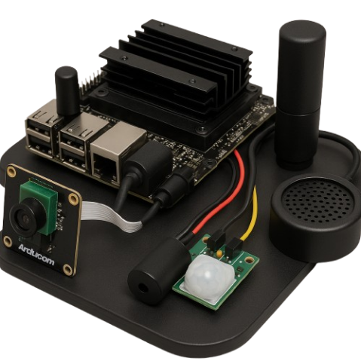
Hardware Requirements
Component | Estimated Cost (USD)
NVIDIA Jetson Nano (4 GB Dev Kit) | $99
Camera Module (USB / Pi Cam V2) | $25
MEMS Mic Array (e.g., ReSpeaker 2-Mic HAT) | $20
Buzzer / Mini Speaker | $5
LED Indicator (optional) | $2
32 GB MicroSD Card (UHS-1) | $10
5V 4A Power Supply | $15
Breadboard & Jumper Wires | $5
Monitor & HDMI Cable (optional) | $15
Estimated total hardware cost: $150 – $170 USD.

Slide 6
Workflow
NVIDIA JETSON NANO
Microphone
Wake-word/signal
Audio AI
Wake word
Cmd recog
Vision AI
Object detect
Face recog
Camera
(Face Detection)
Motion Sensor
Movement
Recording DATA
Store to microSD/SSD
Buzzer / Speaker

Slide 7
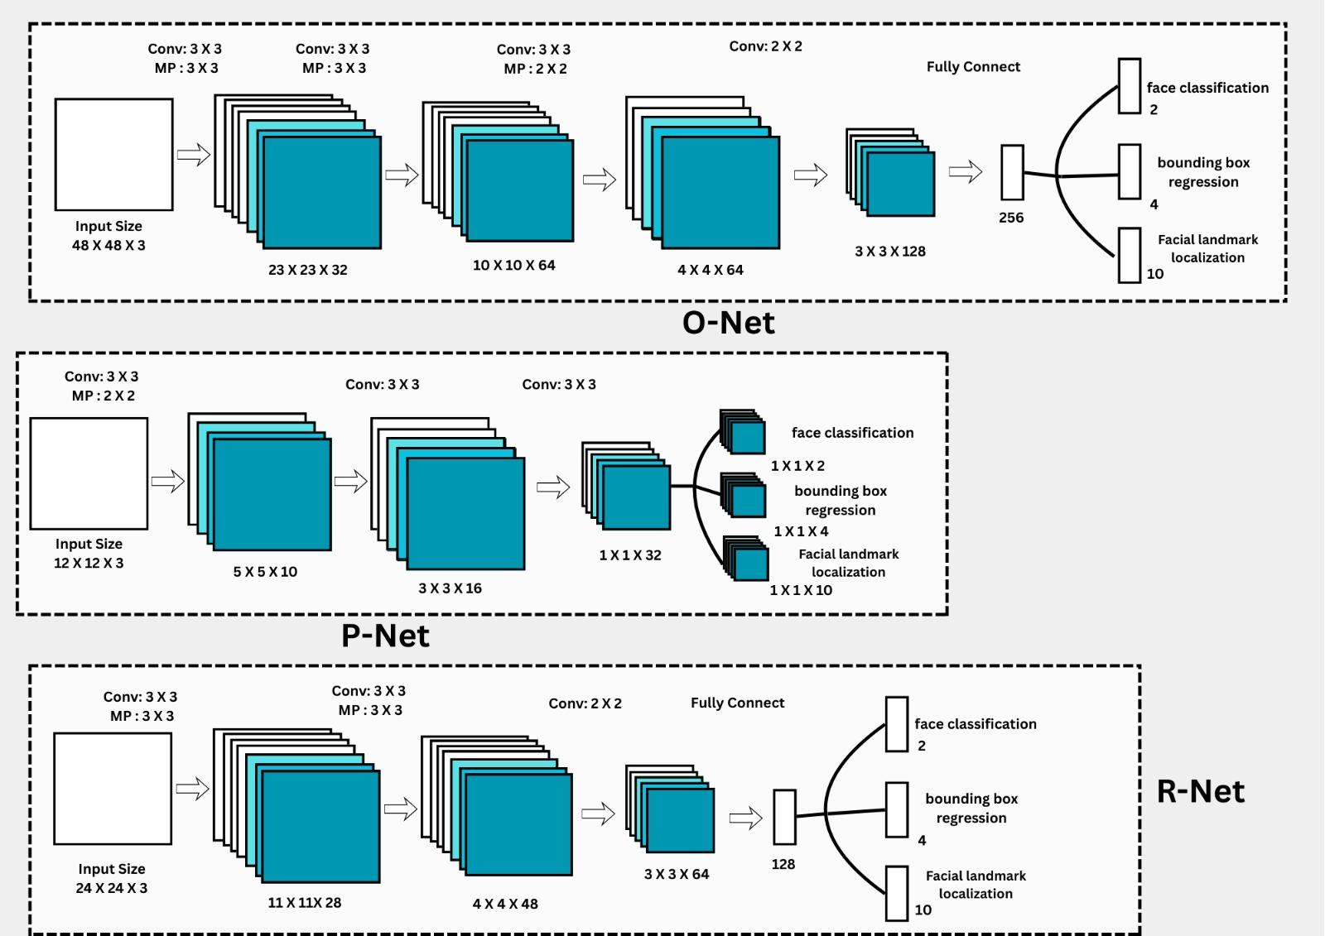
Algorithm
MTCNN is a deep learning model used for face detection and for finding key facial points like the eyes, nose, and mouth.
It is considered a lightweight model because it needs very little training data. MTCNN can work well even with around 4 training images, while regular CNN models usually need more than 1000 images to reach good accuracy.
MTCNN has three main parts: P-Net, R-Net, and O-Net.
P-Net stands for Proposal Network. It gives the first set of possible face regions.
R-Net is the Refine Network. It checks these regions again and improves the bounding boxes.
O-Net is the Output Network. It gives the final results, including the exact face area and the facial landmarks.
All three networks are small convolutional neural networks, which makes the whole model fast. efficient.

Slide 8
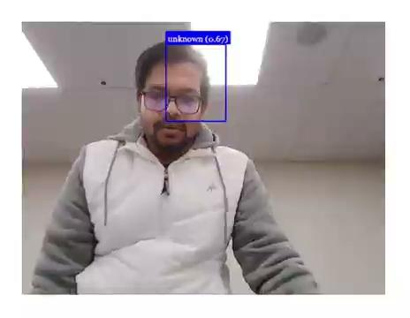
Demo

Slide 9
Future Work (Final)
Jetson Nano Deployment – Implement and optimize the system on Jetson Nano hardware.
Algorithm Verification – Cross-check performance against the target application’s algorithm.
Accuracy Improvement – Enhance model precision and reduce false positives/negatives.
Debugging & Optimization – Fix remaining bugs and streamline performance.
Robust System Design – Strengthen the architecture for stable, real-world operation.

Slide 10
Thank You!

